Slide 1
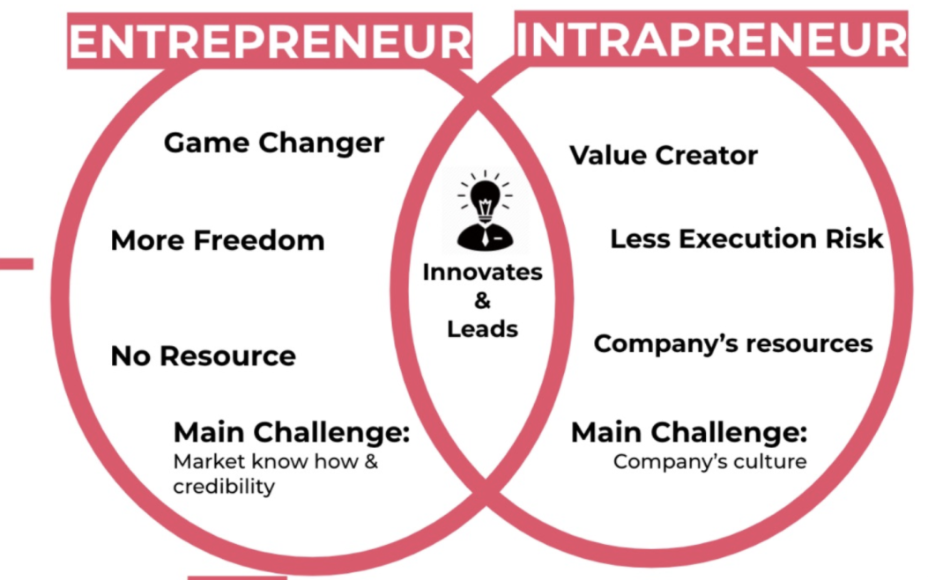
Chapter 3 Corporate Entrepreneurial Mind-Set

Slide 2
Corporate Entrepreneurship
A process that can facilitate firms’ efforts to innovate constantly and cope effectively with the competitive realities.

Slide 3
Is there any connection between “Corporate Entrepreneurial Mind-set” and “Intrapreneurship”????

Slide 4
Reengineering Organizational Thinking
Set explicit innovation goals (mutually agreed by employees and management).
Create a system of feedback and positive reinforcement.
Emphasize individual responsibility, confidence, trust, and accountability.
Provide rewards for innovative ideas.
Do not punish failures.

Slide 5
Do you work in a Entrepreneurial Firm? Do you own Entrepreneurial Firm? Ask these 8 questions from a person who works in the organization that is from the same industry where you want to work (part 2 of project)
Does your company encourage entrepreneurial thinking?
Does your company provide ways for innovators to stay with their ideas?
Are people in your company permitted to do the job in their own way or are they constantly stopping to explain their actions and ask for permission?
Has your company evolved quick and informal ways to access the resources to try new ideas?
Has your company developed ways to manage many small and experimental innovations?
Is your system set up to encourage risk taking and to tolerate mistakes?
Are people in your company more concerned with new ideas or with defending their turf.
How easy is it to form autonomous teams in your corporate environment.

Slide 6
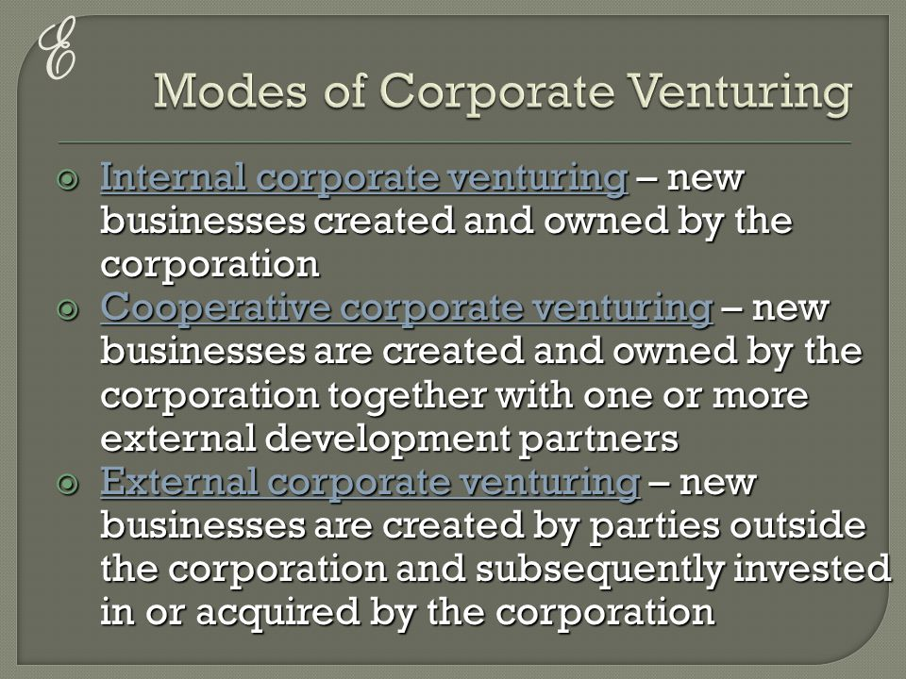

Slide 7
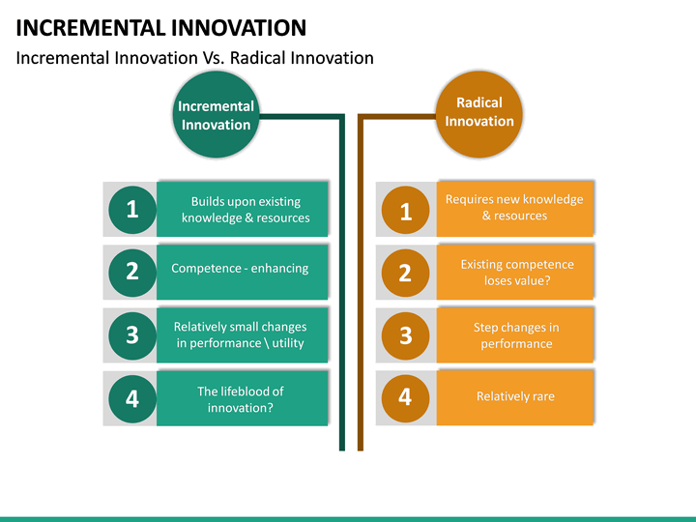

Slide 8
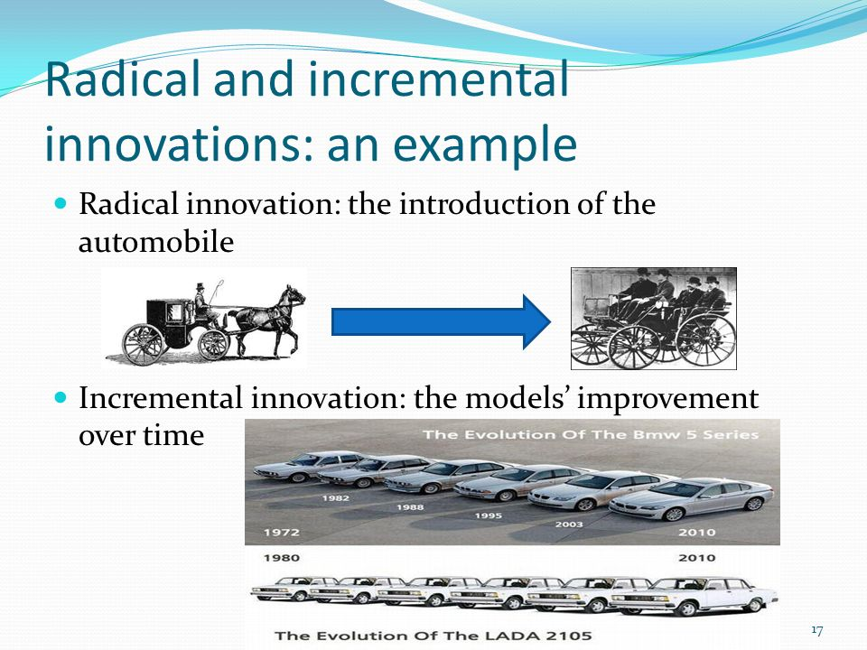

Slide 9
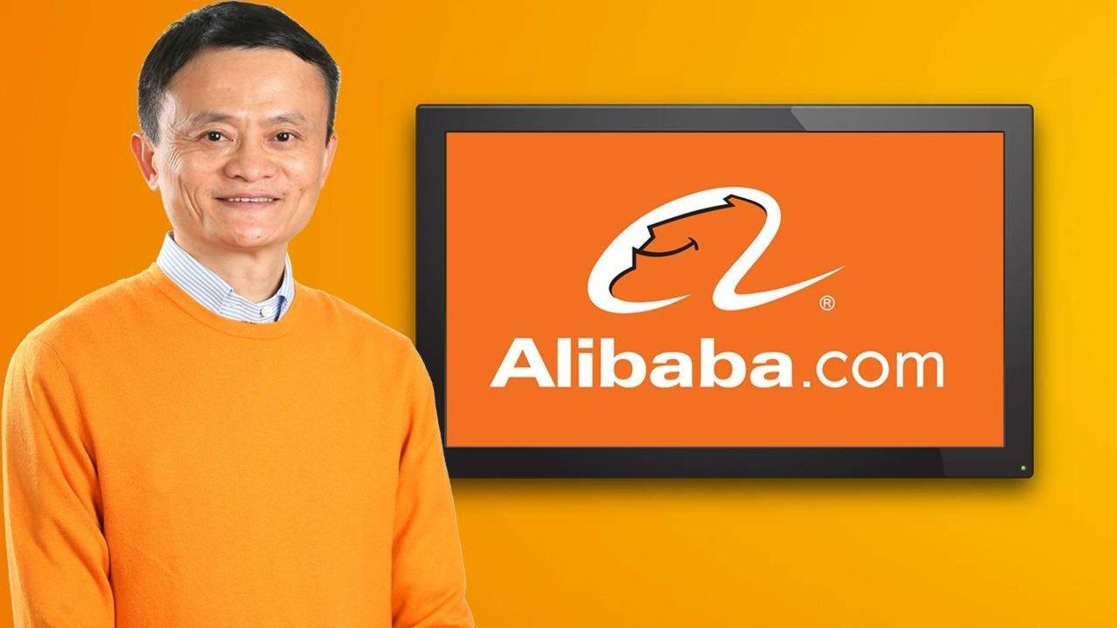

Radical or incremental innovation?

Slide 10


Radical or incremental innovation?

Slide 11
5 critical steps of a corporate entrepreneurship strategy
Developing and sharing the vision (write your personal vision “part 3 of your project)
Encouraging innovation.
Structuring for an entrepreneurial climate.
Developing individual managers for corporate entrepreneurship.
Developing venture teams.

Slide 12
3M Innovation Philosophy
Don’t kill a project.
Tolerate failure.
Keep divisions small.
Motivate the champions.
Stay close to the customers.
Share the wealth (technology).

Slide 13
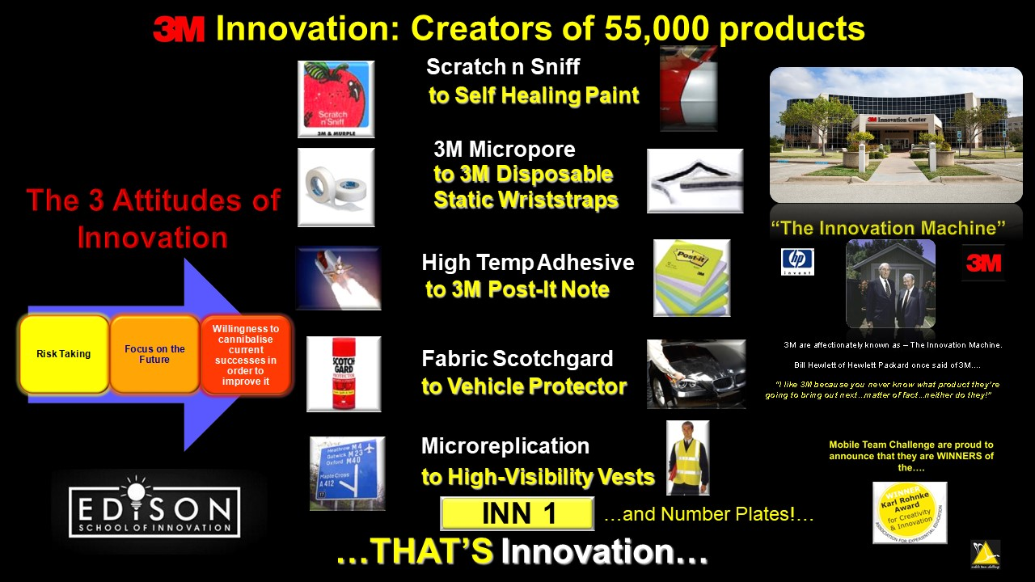
3M Philosophy

Slide 14
Management support to be innovative
Autonomy / work discretion.
Rewards / reinforcement.
Time availability.
Organizational Boundaries.
Organizations should avoid having standard operating procedures for all major parts of jobs, and should reduce dependence on narrow job descriptions and rigid performance standards.

Slide 15
A Timeless Lesson: Signode’s I-Team (Page 88 of our course book)

Slide 16


